Slide 1

Global Warming Analysis and Prediction
ABES Engineering College, Ghaziabad, UP
Department of CSE
Mini-Project Presentation-1
Project Domain: Machine Learning
Project Guide: Mr. Vivek Srivastava
Session: 2023-24
Team Members: 1.Manasvi Kansal (2100320100099)
2.Manya Khare (2100320130106)

Slide 2
Contents
Abstract
Introduction
Objectives
Existing Work related to Project
Requirements of Project
Methodology
Implementation
Outcome
Literature review
References

Slide 3
Abstract
The forecast of long-term global warming could be of huge significance in various fields, such as climate research, farming, electricity, medicine, and many more. The data is calculated and predicted by linear regression since, of all the techniques that can be used, it obtains the highest precision for global warming. Global temperature reduction will benefit the entire globe because not only Humans but also various animals suffer from global warming.

Slide 4

Introduction
In this presentation, we navigate the complexities of climate change, analyzing historical data to predict future scenarios. Through the precision of linear regression, we aim to decipher the patterns of temperature fluctuations, greenhouse gas emissions, and their impact on our planet. Join us in this journey of data-driven exploration, where predictive modeling meets environmental consciousness, guiding us towards a more sustainable future.

Slide 5
Objectives
The primary objective of this project is to employ linear regression analysis to model and understand the relationships between various environmental factors and global temperature changes.
Global temperature reduction will benefit the entire globe because not only Humans but also various animals suffer from global warming.
A model for forecasting data for next 10 years is trained and tested with different input variables is generated

Slide 6
Existing Work of Project
Here are some examples of related previous work:
Climate Modeling Studies
Historical Climate Data Analysis
Regression Analysis in Climate Science
Policy and Decision Support Studies
Predictive Modeling for Climate Change
Interdisciplinary Research
Environmental Impact Assessments
Public Awareness Campaigns
Economic Studies
Global Agreements and Protocols

Slide 7
Requirements of Project
Statistical software packages like R, Python (with libraries such as NumPy, Pandas, and SciPy), or statistical software like SPSS or SAS are commonly used for data analysis and linear regression modeling.
Software like Matplotlib, Seaborn, ggplot2 (for R), or Tableau for creating data visualizations and graphs to present your findings.
Tools for data cleaning, transformation, and preprocessing, such as Excel, OpenRefine, or Python libraries like Pandas and NumPy.
Python libraries like Scikit-Learn and StatsModels for building and validating linear regression models.

Slide 8
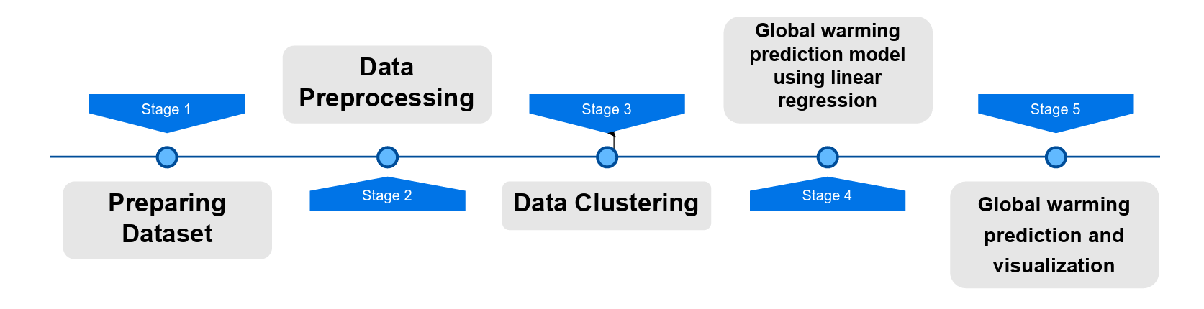
Methodology
Proposed System Architecture

Slide 9
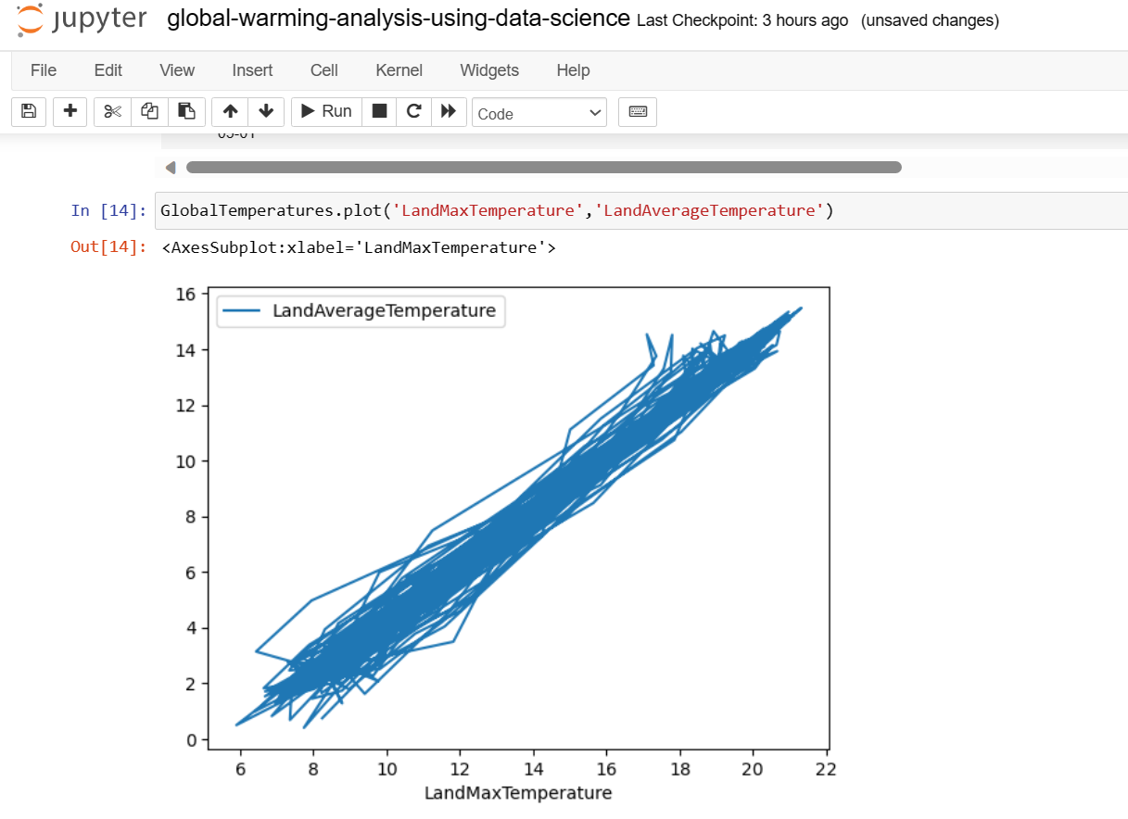
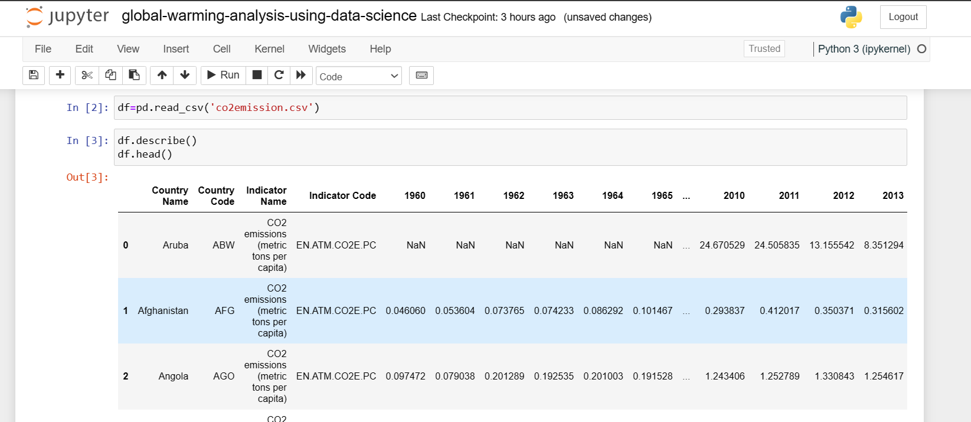
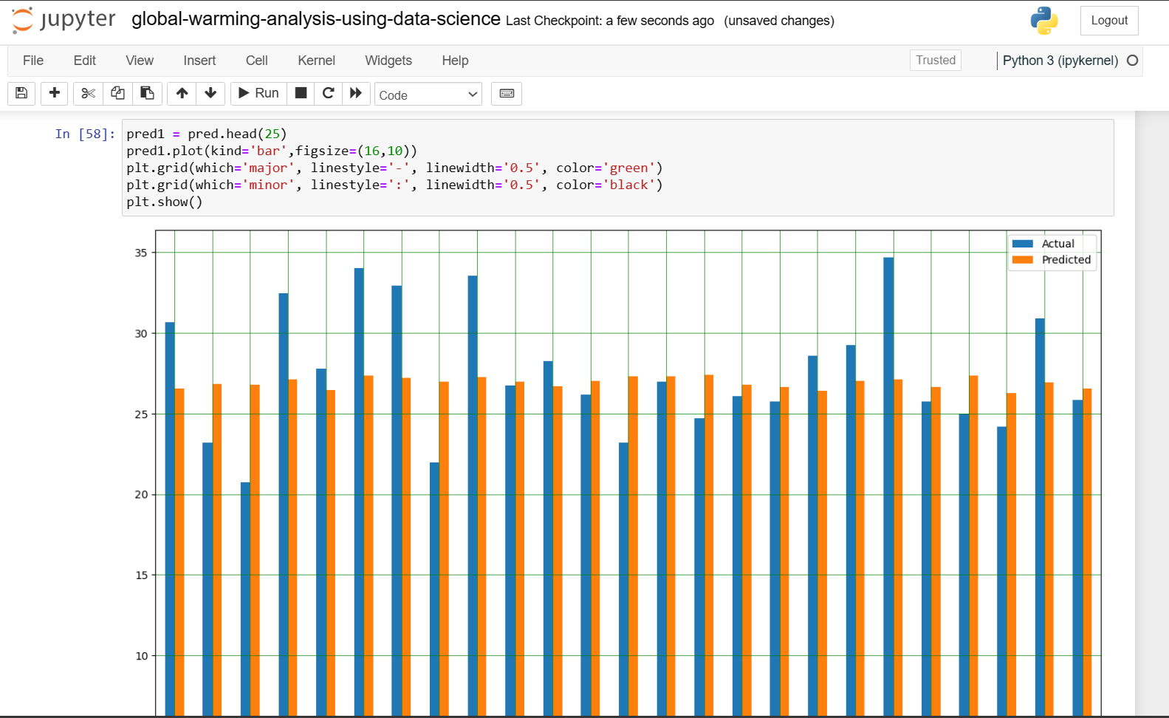
Implementation

Slide 10
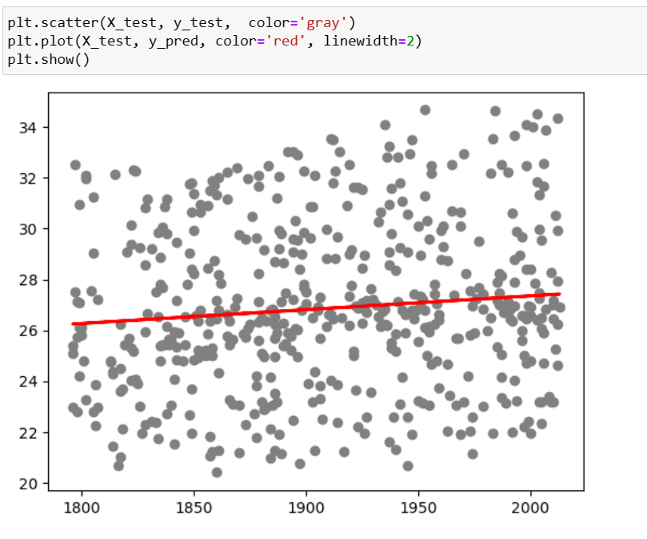
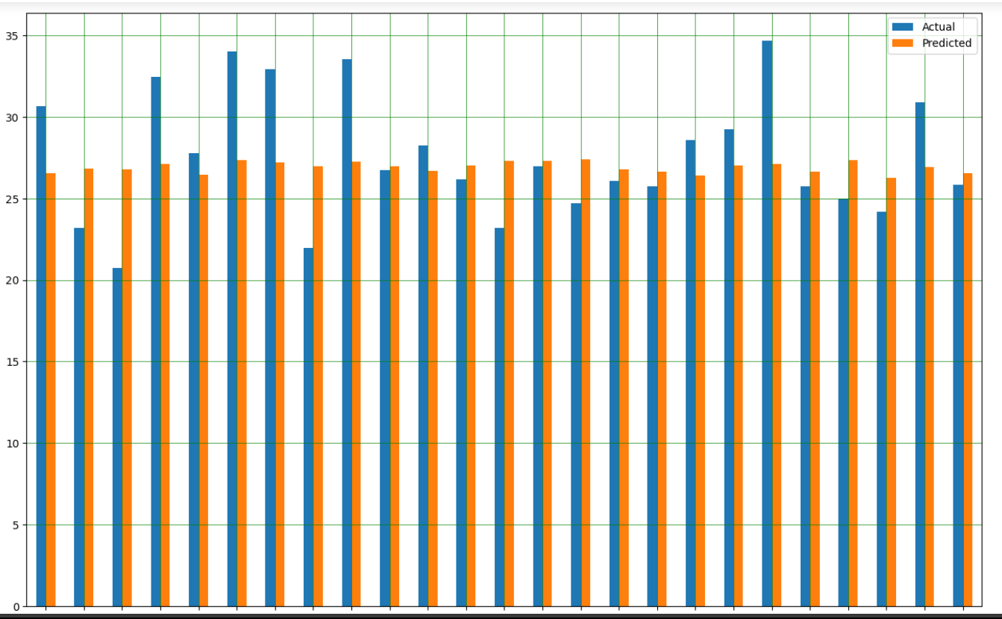
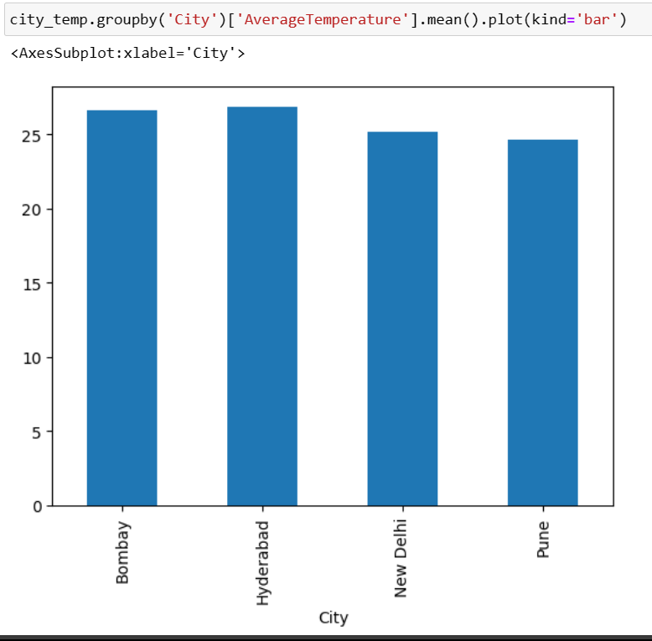
Outcomes

Slide 11
Literature review
S.No. | Title & Author | Source | Year | Findings
1

Slide 12
Literature review

Slide 13
References
“A new approach for simulating and forecasting the rainfall-runoff process within the next two months” by M.J Alizadeh, M.R. Kavianpour, Ozgur Kisi; Vahid Nourani, Journal of Hydrology (Vol – 548); May-2017 .
“Monthly prediction of air temperature in Australia and New Zealand with machine learning algorithms” by S. Salcedo-Sanz, R. C. Deo, L. Carro-Calvo, B. SaavedraMoreno; Theoretical and Applied Climatology (Vol – 125); July-2016 .
“Multiple regression and Artificial Neural Network for long-term rainfall forecasting using large scale climate modes” by F. Mekanik, M.A. Imteaz, S. Gato-Trinidad, A. Elmahdi; Journal of Hydrology (Vol – 503); October-2013.
“Development and Analysis of ANN Models for Rainfall Prediction by Using Time-Series Data” by Neelam Mishra, Hemant Kumar Soni, Sanjiv Sharma, AK Upadhyay; International Journal of Intelligent Systems and Applications; January-2018.
“Application of Artificial Neural Networks to Rainfall Forecasting in Queensland, Australia” by John Abbot and Jennifer Marohasy, Advances in Atmospheric Sciences; July-2012
“Comparison of neural network configuration in the long-range forecast of southwest monsoon rainfall over India” by Snehasish Chakraverty and Pallavi Gupta; Neural Computing and Applications (Vol – 17); March2008

Slide 14
Thank You !

